Slide 1
Bridge Pattern
CS350/SE310
Fall, 2015

Slide 2
What if both abstraction and the implementation will vary?

Slide 3
An Example
Suppose we are writing a program that will draw rectangles for either of two drawing programs (DP1 and DP2).
We will know which we are using at the instantiation of the rectangle.
A rectangle is defined as a pair of two points:
(x2, y2)
(x1, y1)

Slide 4
DP1 and DP 2 use different implementations
DP1: DP2:
draw_a_line(x1, y1, x2, y2) drawline(x1,x2, y1, y2)
draw_a_circle(x, y, r) drawcircle(x, y, r)
(x2, y2)
(x1, y1)

Slide 5
An example
We do not want the code that draws the rectangles to worry about what type of drawing program it should use.
Since the rectangles are told at the time of instantiation what drawing program they use, we could have two different kinds of Drawing objects, one that works of DP1 and one on DP2.

Slide 6
Solution 1:
Use an abstract class to represent a Rectangle.
The only difference between DP1 and DP2’s rectangles are the implementation of the drawline method.
V1Rectangle is implemented by having a reference to a DP1 object that uses the draw_a_line method.
V2Rectangle is implemented by having a reference to a DP2 object that uses the drawline method.
Once a Rectangle is instantiated I no longer have to worry about which it uses.

Slide 7
Solution 1:
abstract public class Rectangle {
private double _x1, _y1, _x2, _y2;
public Rectangle (double x1, double y1, double x2, double y2) {
_x1 = x1; _y1 = y1; _x2 = x2; _y2 = y2;
}
public void draw() {
drawLine(_x1, _y1, _x2, _y1);
drawLine(_x2, _y1, _x2, _y2);
drawLine(_x2, _y2, _x1, _y2);
drawLine(_x1, _y2, _x1, _y1);
}
abstract protected void drawLine (double x1, double y1, double x2, double y2);
}

Slide 8
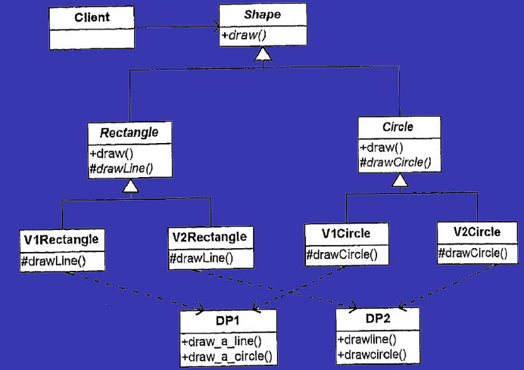
Evolves from solution 1:
What if we add more shapes?

Slide 9
Evolves from solution 1
abstract class Shape {
abstract public void draw();
}
abstract public class Circle extends Shape {
protected double _x, _y, _r;
public Circle (double x, double y, double r) {
_x = x; _y = y; _r = r;
}
public void draw() { drawCircle(); }
abstract protected void drawCircle();
}

Slide 10
Evolves from solution 1
public class V1Circle extends Circle{
public V1Circle(double x, double y, double r) {
super(x,y,r);
}
protected void drawCircle() { DP1.draw_a_circle(_x, _y, _r);}
}
public class V2Circle extends Circle{
public V2Circle(double x, double y, double r) {
super(x,y,r);
}
protected void drawCircle() {
DP2.drawCircle(_x, _y, _r);
}
}

Slide 11
Evolves from solution 1
While intuitive, this method leads to a class explosion.
The abstraction (Shape) and the implementation (drawing programs) are tightly coupled.
Each type of shape must know what kind of drawing program it is using.
We need to separate the variations in abstraction from the variation in implementation.
Abstraction 1 Implementation A
Abstraction 2 Implementation B
Abstraction 3 Implementation C

Slide 12
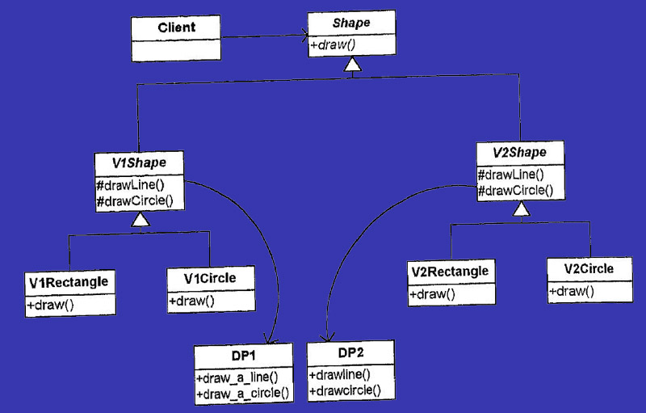
Solution 2:

Slide 13

Solution 3:
Let’s start by identify what is varying.
Different types of shapes
Different types of drawing programs

Slide 14
Solution 3
Shape is used to encapsulate the concept of the types of shapes
Shapes are responsible to know hot to draw themselves
Drawing objects are responsible to draw graphical primitives like lines and circles.
Responsibilities are defined by methods in the classes

Slide 15
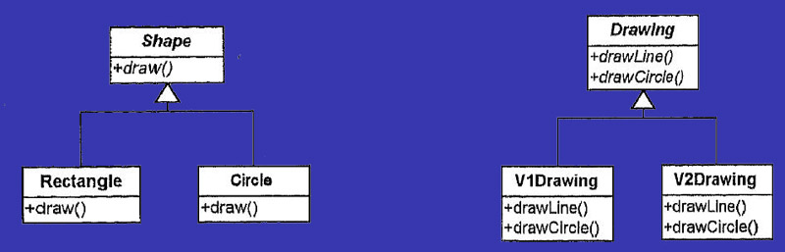
Solution 3
We also must represent the specific variations that are present.
A shape has a rectangle and circle.
A drawing program has a program based on DP1 and one based on DP2

Slide 16
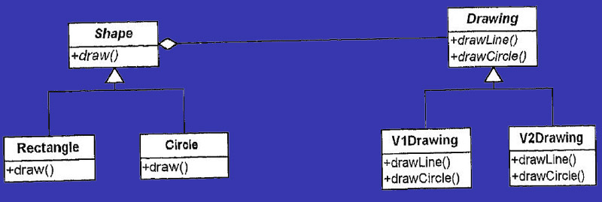
Solution 3: Tie the classes together

Slide 17
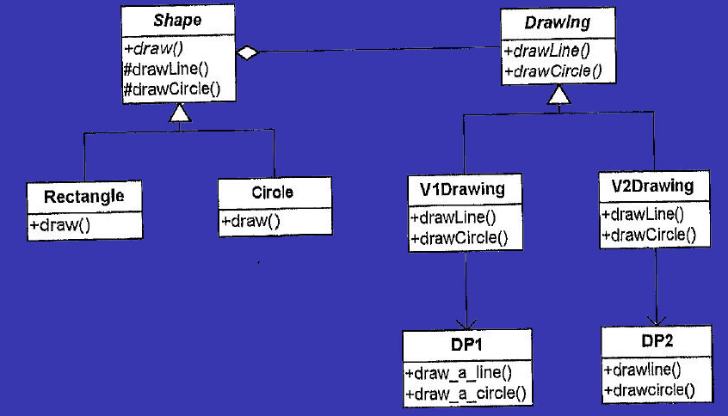
Solution 3:

Slide 18
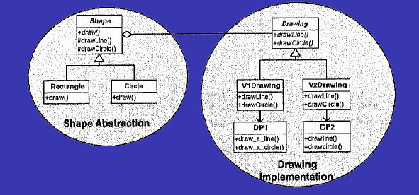
Solution 3: Bridge Pattern
We now have a separation of the abstraction from the implementation

Slide 19
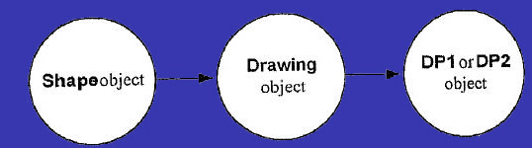
Solution 3: Bridge Pattern
Remember there are only three objects at any given time to consider:
A Shape is either a Circle or Rectangle, but the client can’t tell which, since they both look the same.
A Drawing object is either a V1Drawing or V2Drawing, but the shape can’t tell the difference since they both look the same.
DP1 or DP2 must be the correct one, but the Drawing object that uses it will know which it is.

Slide 20
Solution 3
public class Client {
static public void main() {
Shape myShapes[];
Factory myFactory = new Factory();
//get rectangles from some other source
myShapes = myFactory.getShapes();
for (int i = 0; i < myShapes.length; i++) {
myShapes[i].draw();
}
}
}
abstract public class Shape {
protected Drawing myDrawing;
abstract public void draw();
Shape (Drawing drawing) {
myDrawing = drawing;
}

Slide 21
Solution 3:
protected void drawLine(
double x1, double y1, double x2, double y2) {
myDrawing.drawLine(x1, y1, x2, y2);
}
protected void drawCircle(
double x, double y, double r) {
myDrawing.drawCircle(x,y,r);
}
}
public class Rectangle extends Shape {
private double _x1, _y1, _x2, _y2;
public Rectangle (Drawing dp, double x1,
double y1, double x2, double y2) {
super(dp);
_x1=x1; _y1=y1; _x2=x2; _y2 = y2;//Typo in book
}
public void draw() {
drawLine( _x1, _y1, _x2, _y1);
drawLine( _x2, _y1, _x2, _y2);
drawLine( _x2, _y2, _x2, _y2);
drawLine( _x1, _y2, _x1, _y1);
}

Slide 22
protected void drawLine(double x1, double y1, double x2, double y2) {
myDrawing.DrawLine(x1 y1, x2, y2);
}
}
public class Circle extends Shape {
private double _x, _y, _r;
public Circle (Drawing dp, double x, double, y, double r) {
super(dp);
_x = x; _y = y; _r = r; //Typo in book
}
public void draw() {
myDrawing.drawCircle(_x, _y, _r);
}
}

Slide 23
abstract public class Drawing {
abstract public void drawLine(double x1, double y1, double x2, double y2);
abstract public void drawCircle(double x, double y, double r);
}
public class V1Drawing extends Drawing {
public void drawLine(double x1, double y1, double x2, double y2) {
DP1.draw_a_line(x1,y1,x2,y2);}
public void drawCircle(double x, double y, double r) {
DP1.draw_a_circle(x,y,r);
}
}
public class V2Drawing extends Drawing {
public void drawLine(double x1, double y1, double x2, double y2) {
DP2.drawLine(x1,x2,y1,y2);}
public void drawCircle(double x, double y, double r) {
DP2.drawCircle(x,y,r);
}
}

Slide 24
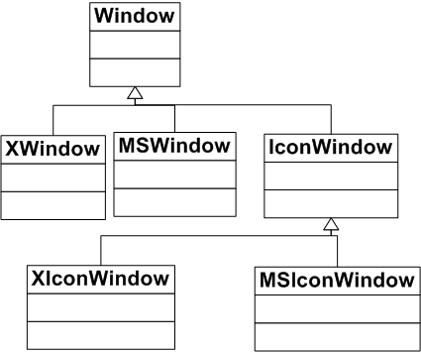
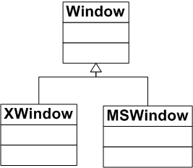
Another Example

Slide 25
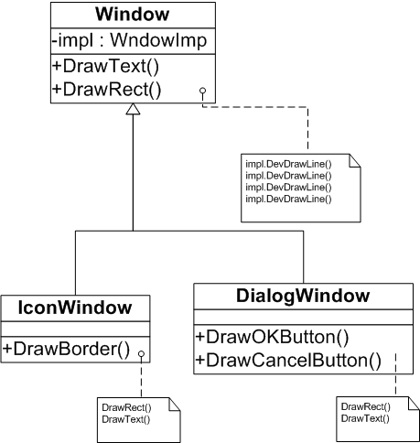
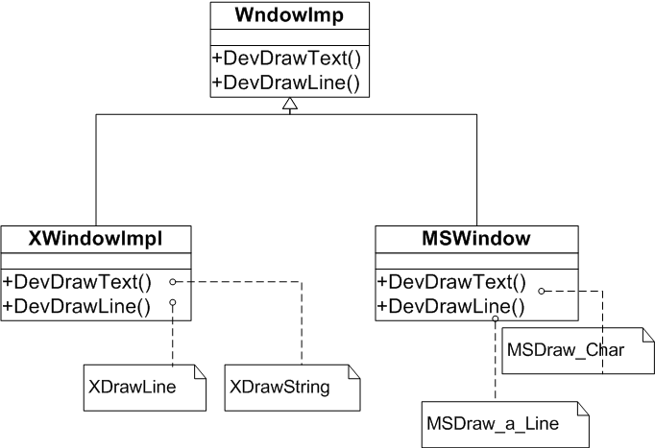
Bridge
Bridge

Slide 26
Bridge Pattern

Slide 27
Consequences of using Bridge
Decoupling interface and implementation - may be configured at runtime - may even be changed
Eliminates compile time dependency on implementation
Encourages layering - resulting in better system
Improved extensibility
Shields clients from implementation details

Slide 28
Bridge Uses and Drawbacks
Useful in graphic and windowing systems that need to run over multiple platform
Useful any time you need to vary an interface and an implementation in different ways
Increases complexity

Slide 29
Participants
Abstraction (Window):
- define the abstraction’s interface
- maintains a reference to an object of type
Implementor
Refined Abstraction (IconWindow, DialogWindow):
- extends the interface defined by Abstraction

Slide 30
Participants (continue)
Implementor (WindowImp):
- defines an interface for implementation
classes. Typically, this Implementor’s
interface provides only primitive menthod
ConcreteImplementor (XWindowImpl, MSWindowImpl):
- implements the Implementor’s interface

Slide 31
Benefits
Avoid permanent binding between an abstraction and its implementation
Avoid nested generalizations
Ease adding new implementations
Reduce code repetition
Allow runtime switching of behaviour

Slide 32
Drawbacks
Double indirection
“Window” operation are implemented by subclasses of WindowImpl class. Window class must delegate the message to a WindowImpl subclass which implements the appropriate method. This will have a slight impact on performance.

Slide 33
Consequences
decoupling interface & implementation
- implementation of abstraction - can be configured at run-time
- eliminate compile time dependencies on implementation
- encourages layering
improved extensibility
- Abstraction & Implementer - can be extended independently
hiding implementation details from clients

Slide 34
Bridge Vs. Other Patterns
Abstract Factory can create and configure a particular Bridge
Bridge vs. Strategy

